Slide 1
STUDENT MANGEMENT SYSTEM
COURSE CODE : CSE – 0318
COURSE NAME : Software Engineering lab
STATE UNIVERSITY OF BANGLADESH
SUBMITTED BY ,
MUSHIUR RAHMAN ANY
UG02-47-17-019
DEPARTMENT OF CSE
SUBMITTED TO
KHAN MD HASIB
LECTURE DEOARTMENT OF CSE

Slide 2

INTRODUCTION
Maintain record of all valuable information about every student
Student Management System (SMS) is software application for the education that can be used to managed student information and data. This system is designed for school to help administrators and in the management of students.
Student’s record can be edited as per requirement.
Change of password email contact can be done easily.

Slide 3
REQUIREMENTS
PHP
MYSQL FOR THE DATABASE
Front End: Java Swing
Back End: MySQL
Intellij .

Slide 4
PROJECT SUMMARY
Users of the System
1. Admin
2. Accountant
Functional Requirements
1. Admin
1. Can add/view/edit/delete accountant
2. Can logout
2. Accountant
1. Can add/view/edit/delete students
2. Can check due fee
3. Can logout

Slide 5
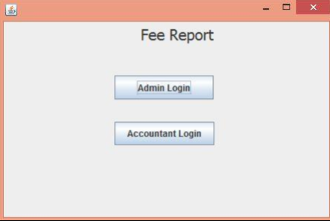
PROPOSED METHODOLOGY
HOME PAGE

Slide 6
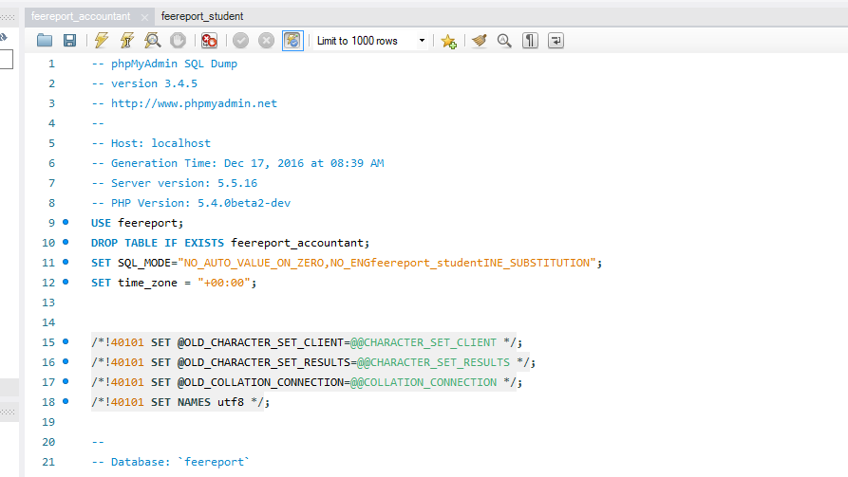
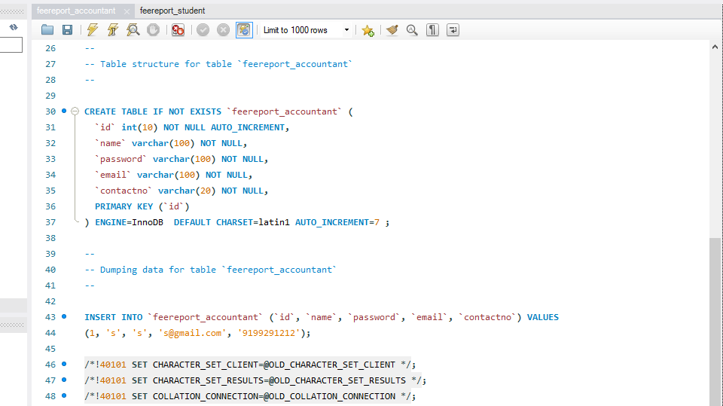
ACCOUNTANT

Slide 7
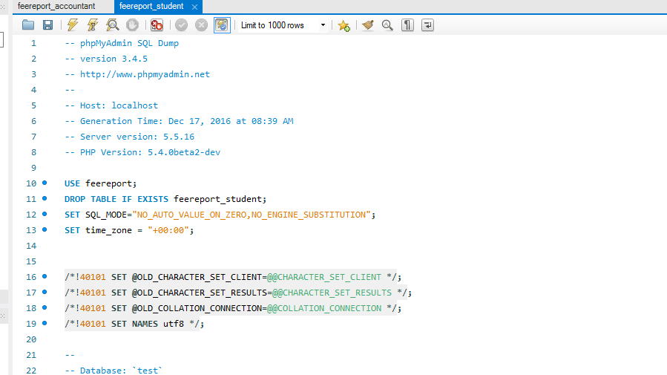
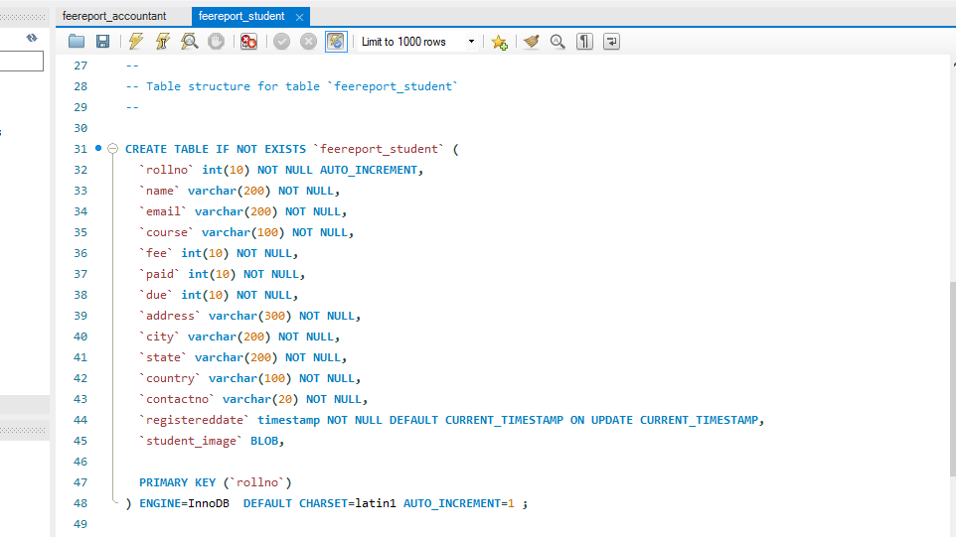
ADMIN

Slide 8
ADVANTAGES
Better Utilization of Time & Resources.
Enhanced Productivity.
Centralized Database for Information Management.
Improved Student Success.
Better Parental Involvement.
Cloud-Based SIS for Enhanced Security.

Slide 9
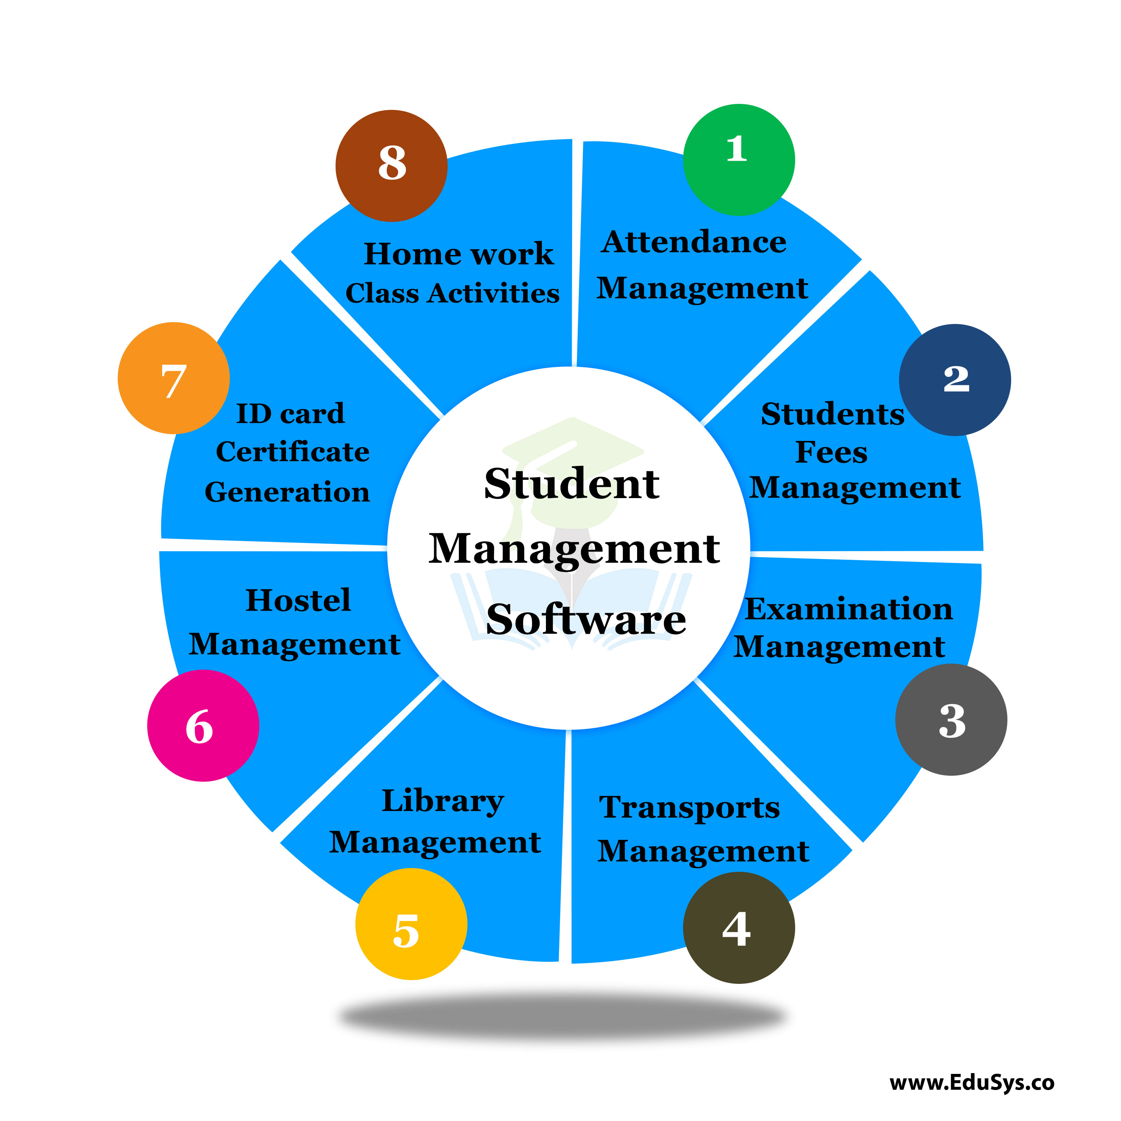
CONCLUSION AND FUTURE WORK
It was a wonderful and learning experience for us while working on this project.
This software is very easy to use so all educational institute can use this frequently.
So, we can hope that our software will be very popular and get to develop in future

Slide 10
THANK YOU

